Slide 1
Code Cypher end-to-end encrypter
Bhavya chopra
Shantanu roy

Slide 2
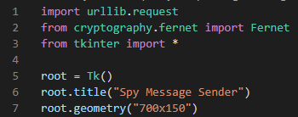
Sender.py
Importing libraries and setting up the base gui window for tkinter

Slide 3
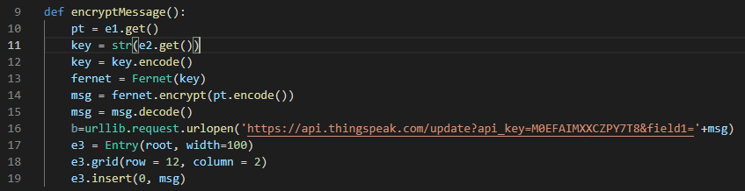
Making a function that’s run once the button is clicked –
We get the key and raw text from the input boxes using get
.encode() converts strings to bits
Fernet is initialising a keyword with Fernet
We push the message to the thingspeak api where we have put our own api key
Finally we create a another entry (tkinter box) to show the encrypted text that is sent to the api

Slide 4
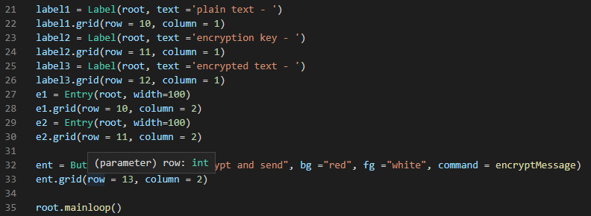
GUI content (labels for text and Entry for input boxes, we also setup a button to call the function
Root mainloop keeps the tkinter gui running in loop

Slide 5
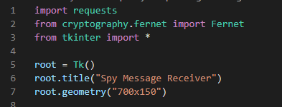
Receiever.py
Importing libraries and setting up the base gui window for tkinter

Slide 6
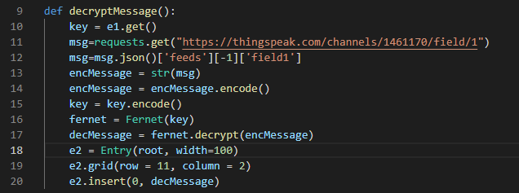
Making a function that’s run once the button is clicked –
First, we get the key from the input box and convert it into bits
We then get the message from the api (from a json) and then we convert it into a string
We setup fernet keyword for Fernet(Key) to initialise fernet
We then decrypt the encMessage using .decrypt()
Now we make an entry box to show the decrypted message
We then insert the decrypted message to entry box e2

Slide 7
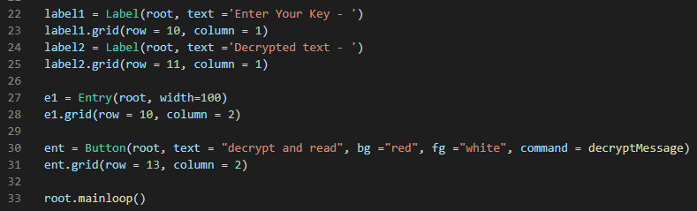
GUI content (labels for text and Entry for input boxes, we also setup a button to call the function
Root mainloop keeps the tkinter gui running in loop

